Slide 1

Data Structures and Algorithms
Analysis of Algorithms

Slide 2
Acknowledgement
The contents of these slides have origin from School of Computing, National University of Singapore.
We greatly appreciate support from Mr. Aaron Tan Tuck Choy, and Dr. Low Kok Lim for kindly sharing these materials.

Slide 3
Policies for students
These contents are only used for students PERSONALLY.
Students are NOT allowed to modify or deliver these contents to anywhere or anyone for any purpose.

Slide 4
Recording of modifications
Course website address is changed to http://sakai.it.tdt.edu.vn
Course codes cs1010, cs1020, cs2010 are placed by 501042, 501043, 502043 respectively.

Slide 5
Objectives
To introduce the theoretical basis for measuring the efficiency of algorithms
1
To learn how to use such measure to compare the efficiency of different algorithms
2

Slide 6
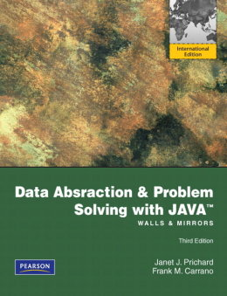

References
Book
Chapter 10: Algorithm Efficiency and Sorting, pages 529 to 541.
IT-TDT Sakai 🡪 501043 website 🡪 Lessons
http://sakai.it.tdt.edu.vn
[501043 Lecture 11: Analysis of Algorithms]

Slide 7
Programs used in this lecture
TimeTest.java
CompareRunningTimes1.java
CompareRunningTimes2.java
CompareRunningTimes3.java
[501043 Lecture 11: Analysis of Algorithms]

Slide 8
Outline
What is an Algorithm?
What do we mean by Analysis of Algorithms?
Algorithm Growth Rates
Big-O notation – Upper Bound
How to find the complexity of a program?
Some experiments
Equalities used in analysis of algorithms
[501043 Lecture 11: Analysis of Algorithms]

Slide 9
You are expected to know…
Proof by induction
Operations on logarithm function
Arithmetic and geometric progressions
Their sums
Linear, quadratic, cubic, polynomial functions
ceiling, floor, absolute value
[501043 Lecture 11: Analysis of Algorithms]
Notes:
Quadratic: bậc 2
Cubic: bậc 3
polynomial : đa thức

Slide 10
1 What is an algorithm?

Slide 11
1 Algorithm
A step-by-step procedure for solving a problem.
Properties of an algorithm:
Each step of an algorithm must be exact.
An algorithm must terminate.
An algorithm must be effective.
An algorithm should be general.
Exact
Terminate
Effective
General
[501043 Lecture 11: Analysis of Algorithms]

Slide 12
2 What do we mean by Analysis of Algorithms?

Slide 13
2.1 What is Analysis of Algorithms?
Analysis of algorithms
Provides tools for contrasting the efficiency of different methods of solution (rather than programs)
Complexity of algorithms
A comparison of algorithms
Should focus on significant differences in the efficiency of the algorithms
Should not consider reductions in computing costs due to clever coding tricks. Tricks may reduce the readability of an algorithm.
[501043 Lecture 11: Analysis of Algorithms]

Slide 14
2.2 Determining the Efficiency of Algorithms
To evaluate rigorously the resources (time and space) needed by an algorithm and represent the result of the analysis with a formula
We will emphasize more on the time requirement rather than space requirement here
The time requirement of an algorithm is also called its time complexity
[501043 Lecture 11: Analysis of Algorithms]

Slide 15
2.3 By measuring the run time?
TimeTest.java
public class TimeTest {
public static void main(String[] args) {
long startTime = System.currentTimeMillis();
long total = 0;
for (int i = 0; i < 10000000; i++) {
total += i;
}
long stopTime = System.currentTimeMillis();
long elapsedTime = stopTime - startTime;
System.out.println(elapsedTime);
}
}
Note: The run time depends on the compiler, the computer used, and the current work load of the computer.
[501043 Lecture 11: Analysis of Algorithms]

Slide 16
2.4 Exact run time is not always needed
Using exact run time is not meaningful when we want to compare two algorithms
coded in different languages,
using different data sets, or
running on different computers.
[501043 Lecture 11: Analysis of Algorithms]

Slide 17
2.5 Determining the Efficiency of Algorithms
Difficulties with comparing programs instead of algorithms
How are the algorithms coded?
Which compiler is used?
What computer should you use?
What data should the programs use?
Algorithm analysis should be independent of
Specific implementations
Compilers and their optimizers
Computers
Data
[501043 Lecture 11: Analysis of Algorithms]

Slide 18
2.6 Execution Time of Algorithms
Instead of working out the exact timing, we count the number of some or all of the primitive operations (e.g. +, -, *, /, assignment, …) needed.
Counting an algorithm's operations is a way to assess its efficiency
An algorithm’s execution time is related to the number of operations it requires.
Examples
Traversal of a linked list
Towers of Hanoi
Nested Loops
[501043 Lecture 11: Analysis of Algorithms]

Slide 19
3 Algorithm Growth Rates

Slide 20
3.1 Algorithm Growth Rates (1/2)
An algorithm’s time requirements can be measured as a function of the problem size, say n
An algorithm’s growth rate
Enables the comparison of one algorithm with another
Examples
Algorithm A requires time proportional to n²
Algorithm B requires time proportional to n
Algorithm efficiency is typically a concern for large problems only. Why?
[501043 Lecture 11: Analysis of Algorithms]

Slide 21
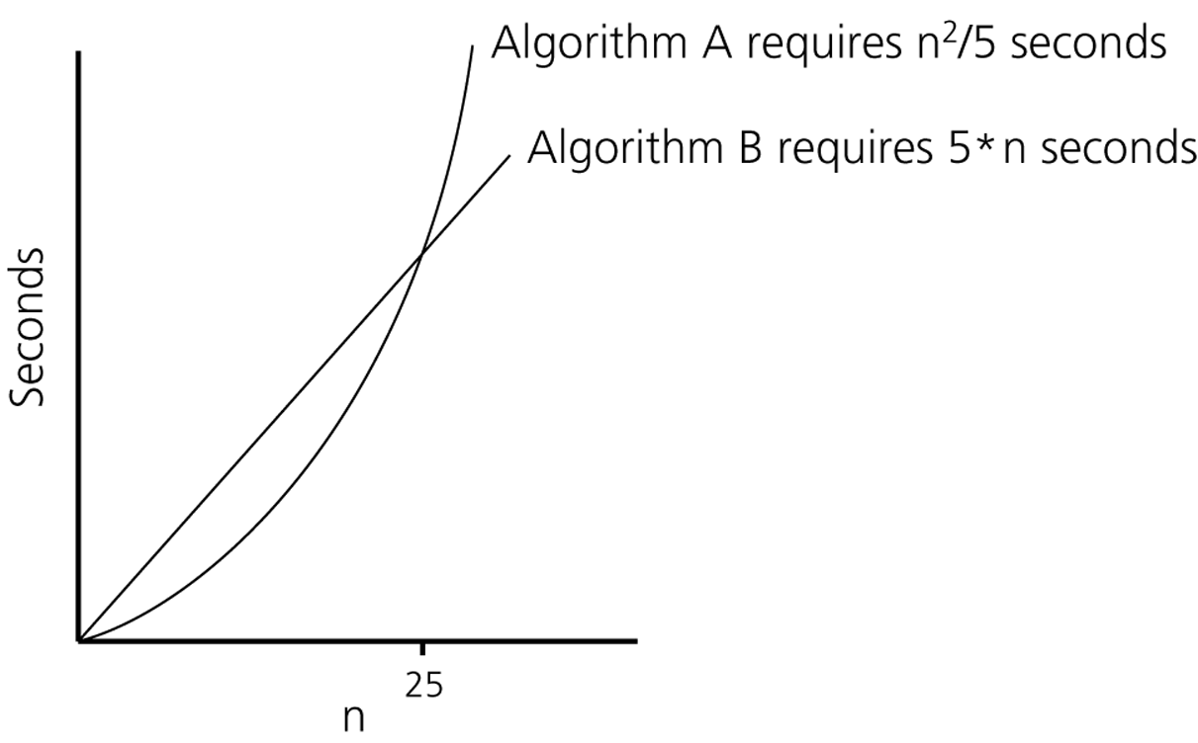
3.1 Algorithm Growth Rates (2/2)
Problem size
Figure - Time requirements as a function of the problem size n
[501043 Lecture 11: Analysis of Algorithms]

Slide 22

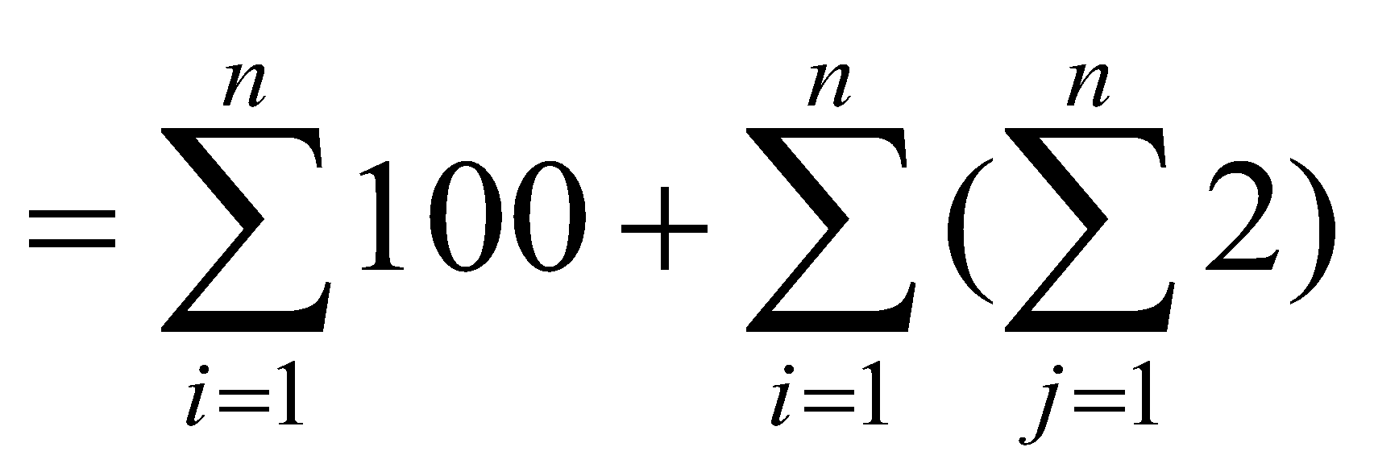
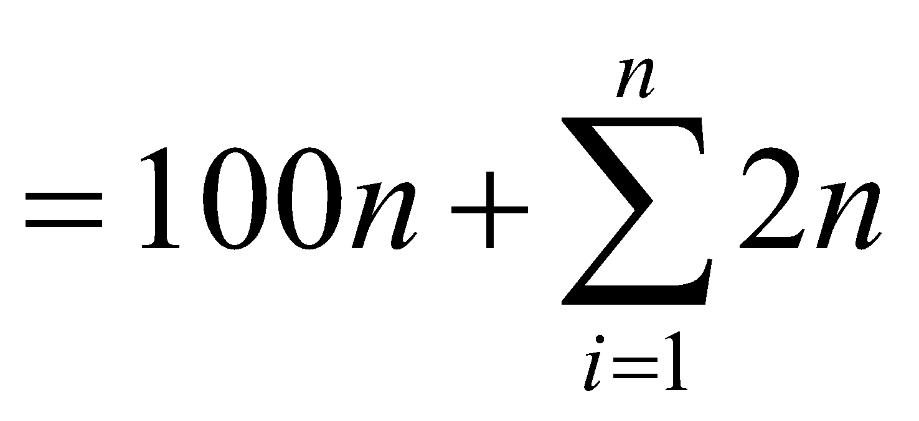
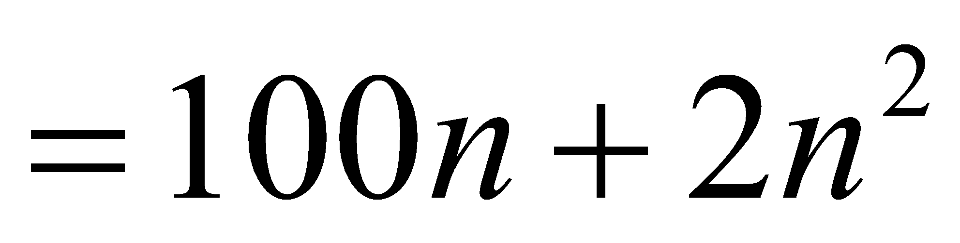
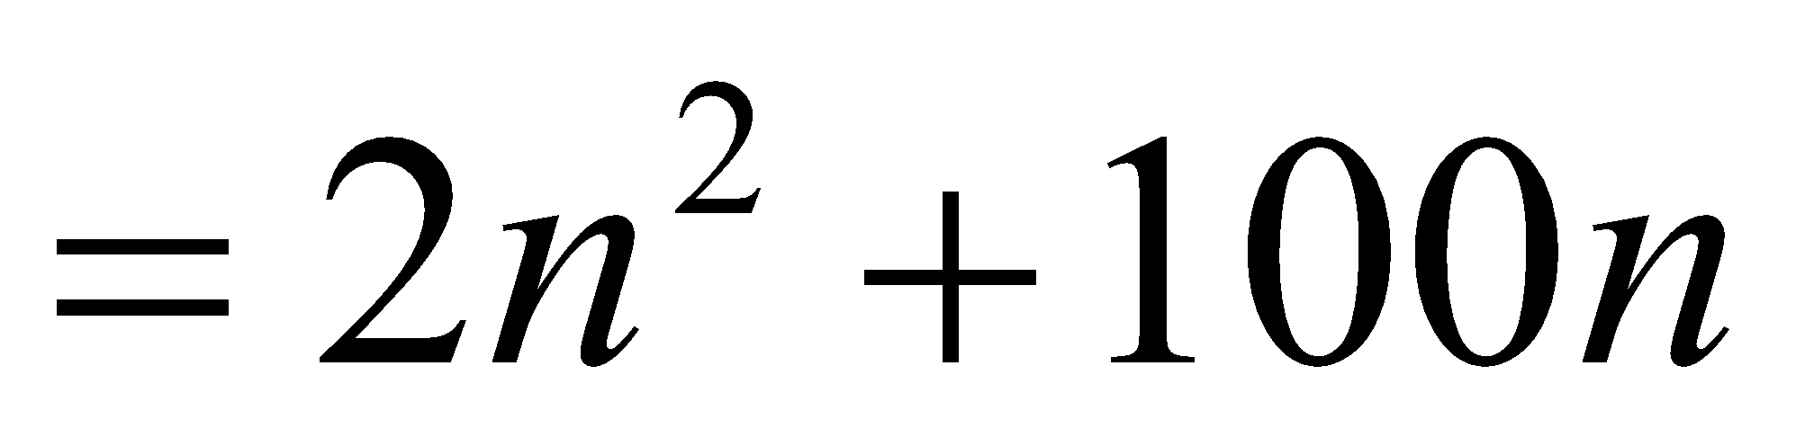
3.2 Computation cost of an algorithm
How many operations are required?
for (int i=1; i<=n; i++) {
perform 100 operations; // A
for (int j=1; j<=n; j++) {
perform 2 operations; // B
}
}
Total Ops = A + B
[501043 Lecture 11: Analysis of Algorithms]

Slide 23
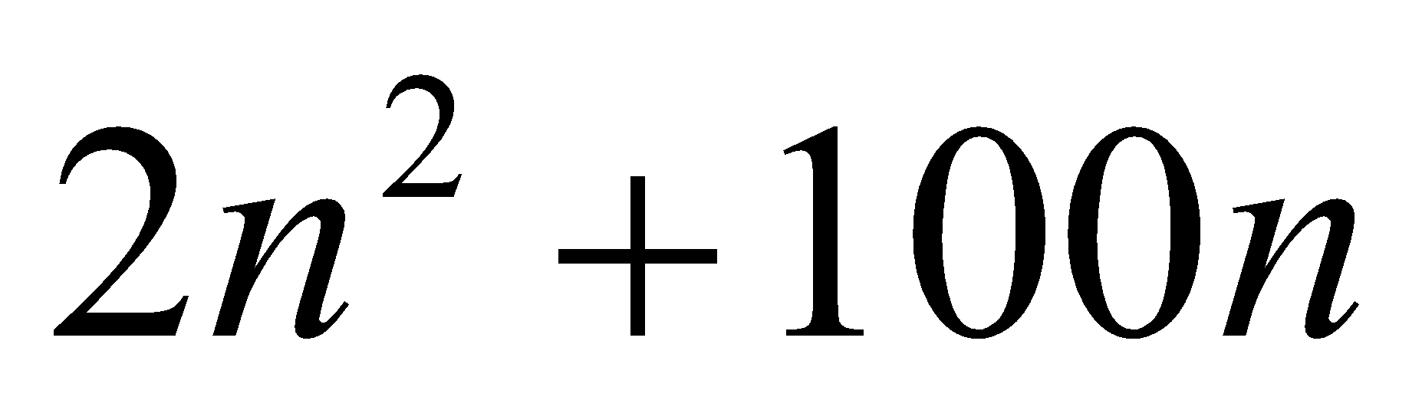
3.3 Counting the number of statements
To simplify the counting further, we can ignore
the different types of operations, and
different number of operations in a statement,
and simply count the number of statements executed.
So, total number of statements executed in the previous example is
[501043 Lecture 11: Analysis of Algorithms]

Slide 24
3.4 Approximation of analysis results
Very often, we are interested only in using a simple term to indicate how efficient an algorithm is. The exact formula of an algorithm’s performance is not really needed.
Example:
Given the formula: 3n² + 2n + log n + 1/(4n)
the dominating term 3n² can tell us approximately how the algorithm performs.
What kind of approximation of the analysis of algorithms do we need?
[501043 Lecture 11: Analysis of Algorithms]

Slide 25
3.5 Asymptotic analysis
Asymptotic analysis is an analysis of algorithms that focuses on
analyzing the problems of large input size,
considering only the leading term of the formula, and
ignoring the coefficient of the leading term
Some notations are needed in asymptotic analysis
[501043 Lecture 11: Analysis of Algorithms]
Notes:
Asymptotic : tiệm cận
coefficient : hệ số

Slide 26
4 Big O notation

Slide 27
4.1 Definition
Given a function f(n), we say g(n) is an (asymptotic) upper bound of f(n), denoted as f(n) = O(g(n)), if there exist a constant c > 0, and a positive integer n₀ such that f(n) ≤ c*g(n) for all n ≥ n₀.
f(n) is said to be bounded from above by g(n).
O() is called the “big O” notation.
c*g(n)
f(n)
g(n)
n₀
[501043 Lecture 11: Analysis of Algorithms]

Slide 28
O(1)
O(logn)
O(n)
O(nlogn)
O(n^2)
O(n^3)
O(2^n)
Độ phức tạp nó phải rơi vào các hàm này

Slide 29
O(1): câu lệnh gán, điều kiện, công thức tính toán
Quy tắc cộng: dành cho những câu lệnh cùng cấp, độ phức tạp của nó là giá trị max.
Quy tắc nhân: dành cho những khối lệnh lồng với nhau

Slide 30
4.2 Ignore the coefficients of all terms
Based on the definition, 2n² and 30n² have the same upper bound n², i.e.,
2n² = O(n²)
30n² = O(n²)
They differ only in the choice of c.
Therefore, in big O notation, we can omit the coefficients of all terms in a formula:
Example: f(n) = 2n² + 100n = O(n²) + O(n)
Why?
◈
[501043 Lecture 11: Analysis of Algorithms]

Slide 31
4.3 Finding the constants c and n₀
Given f(n) = 2n² + 100n, prove that f(n) = O(n²).
Observe that: 2n² + 100n ≤ 2n² + n² = 3n² whenever n ≥ 100.
Set the constants to be c = 3 and n₀ = 100.
By definition, we have f(n) = O(n²).
Notes:
n² ≤ 2n² + 100n for all n, i.e., g(n) ≤ f(n), and yet g(n) is an asymptotic upper bound of f(n)
c and n₀ are not unique.
For example, we can choose c = 2 + 100 = 102, and n₀ = 1 (because f(n) ≤ 102n² ∀ n ≥ 1)
Q: Can we write f(n) = O(n³)?
◈
[501043 Lecture 11: Analysis of Algorithms]

Slide 32
4.4 Is the bound tight?
The complexity of an algorithm can be bounded by many functions.
Example:
Let f(n) = 2n² + 100n.
f(n) is bounded by n², n³, n⁴ and many others according to the definition of big O notation.
Hence, the following are all correct:
f(n) = O(n²); f(n) = O(n³); f(n) = O(n⁴)
However, we are more interested in the tightest bound which is n² for this case.
[501043 Lecture 11: Analysis of Algorithms]

Slide 33
4.5 Growth Terms: Order-of-Magnitude
In asymptotic analysis, a formula can be simplified to a single term with coefficient 1
Such a term is called a growth term (rate of growth, order of growth, order-of-magnitude)
The most common growth terms can be ordered as follows: (note: many others are not shown)
O(1) < O(log n) < O(n) < O(n log n) < O(n²) < O(n³) < O(2^{n}) < …
“fastest”
“slowest”
Note:
“log” = log base 2, or log₂; “log₁₀” = log base 10; “ln” = log base e. In big O, all these log functions are the same. (Why?)
[501043 Lecture 11: Analysis of Algorithms]

Slide 34

4.6 Examples on big O notation
f1(n) = ½n + 4
= O(n)
f2(n) = 240n + 0.001n²
= O(n²)
f3(n) = n log n + log n + n log (log n)
= O(n log n)
Why?
[501043 Lecture 11: Analysis of Algorithms]

Slide 35
4.7 Exponential Time Algorithms
Suppose we have a problem that, for an input consisting of n items, can be solved by going through 2^{n} cases
We say the complexity is exponential time
Q: What sort of problems?
We use a supercomputer that analyses 200 million cases per second
Input with 15 items, 164 microseconds
Input with 30 items, 5.36 seconds
Input with 50 items, more than two months
Input with 80 items, 191 million years!
[501043 Lecture 11: Analysis of Algorithms]
Notes:
Exponential: số mũ

Slide 36
4.8 Quadratic Time Algorithms
Suppose solving the same problem with another algorithm will use 300n² clock cycles on a 80386, running at 33MHz (very slow old PC)
We say the complexity is quadratic time
Input with 15 items, 2 milliseconds
Input with 30 items, 8 milliseconds
Input with 50 items, 22 milliseconds
Input with 80 items, 58 milliseconds
What observations do you have from the results of these two algorithms? What if the supercomputer speed is increased by 1000 times?
It is very important to use an efficient algorithm to solve a problem
[501043 Lecture 11: Analysis of Algorithms]

Slide 37
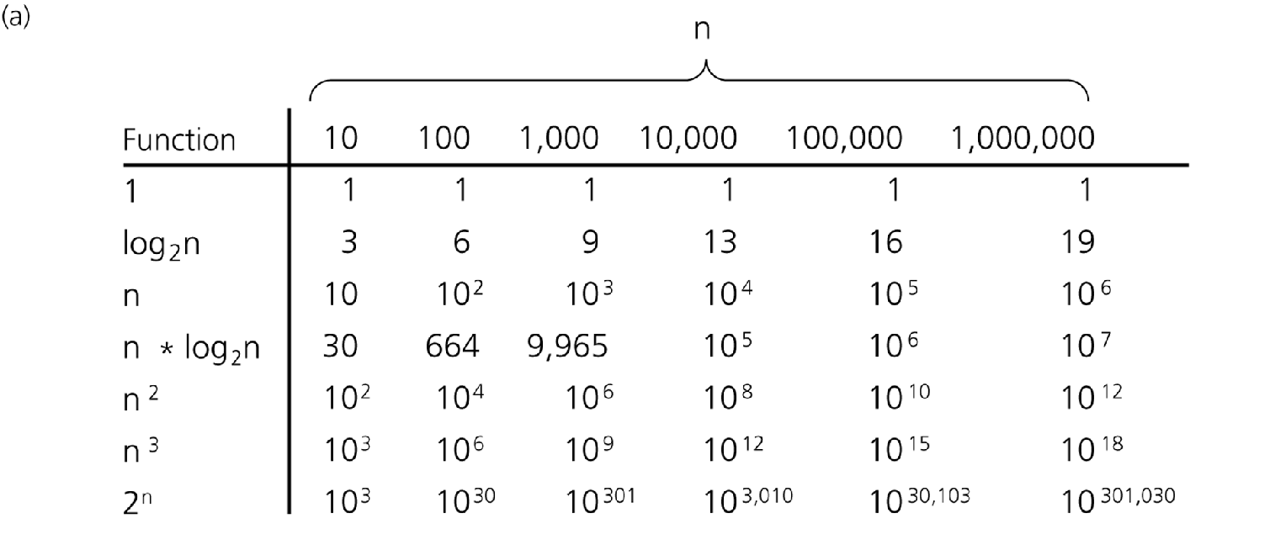
4.9 Order-of-Magnitude Analysis and Big O Notation (1/2)
Figure - Comparison of growth-rate functions in tabular form
[501043 Lecture 11: Analysis of Algorithms]

Slide 38
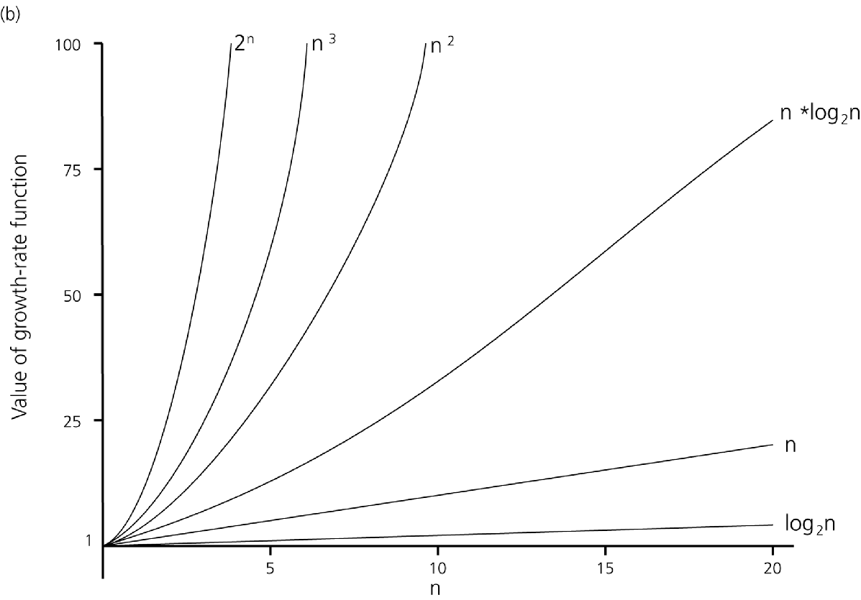
4.9 Order-of-Magnitude Analysis and Big O Notation (2/2)
Figure - Comparison of growth-rate functions in graphical form
[501043 Lecture 11: Analysis of Algorithms]

Slide 39

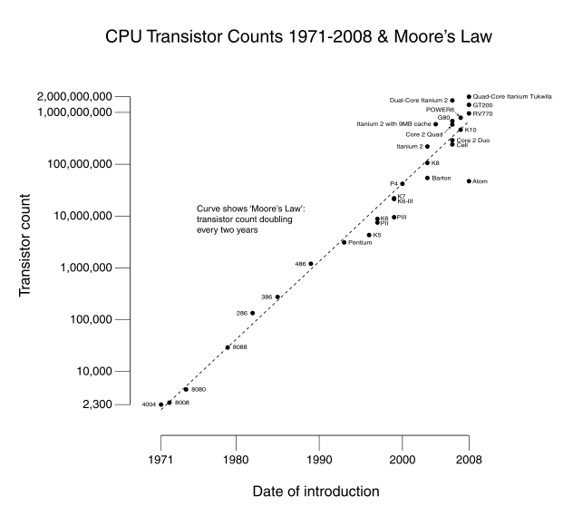
4.10 Example: Moore’s Law
Intel co-founder Gordon Moore is a visionary. In 1965, his prediction, popularly known as Moore's Law, states that the number of transistors per square inch on an integrated circuit chip will be increased exponentially, double about every two years. Intel has kept that pace for nearly 40 years.
[501043 Lecture 11: Analysis of Algorithms]

Slide 40
4.11 Summary: Order-of-Magnitude Analysis and Big O Notation
Order of growth of some common functions:
O(1) < O(log n) < O(n) < O(n log n) < O(n²) < O(n³) < O(2^{n}) < …
Properties of growth-rate functions
You can ignore low-order terms
You can ignore a multiplicative constant in the high-order term
O(f(n)) + O(g(n)) = O( f(n) + g(n) )
[501043 Lecture 11: Analysis of Algorithms]

Slide 41
5 How to find the complexity of a program?

Slide 42
5.1 Some rules of thumb and examples
Basically just count the number of statements executed.
If there are only a small number of simple statements in a program – O(1)
If there is a ‘for’ loop dictated by a loop index that goes up to n – O(n)
If there is a nested ‘for’ loop with outer one controlled by n and the inner one controlled by m – O(n*m)
For a loop with a range of values n, and each iteration reduces the range by a fixed constant fraction (eg: ½) – O(log n)
For a recursive method, each call is usually O(1). So
if n calls are made – O(n)
if n log n calls are made – O(n log n)
[501043 Lecture 11: Analysis of Algorithms]

Slide 43
5.2 Examples on finding complexity (1/2)
What is the complexity of the following code fragment?
int sum = 0;
for (int i=1; i<n; i=i*2) {
sum++;
}
It is clear that sum is incremented only when
i = 1, 2, 4, 8, …, 2^{k} where k = ⎣log₂ n⎦
There are k+1 iterations. So the complexity is O(k) or O(log n)
Note:
In Computer Science, log n means log₂ n.
When 2 is replaced by 10 in the ‘for’ loop, the complexity is O(log₁₀ n) which is the same as O(log₂ n). (Why?)
log₁₀ n = log₂ n / log₂ 10
[501043 Lecture 11: Analysis of Algorithms]

Slide 44
5.2 Examples on finding complexity (2/2)
What is the complexity of the following code fragment? (For simplicity, let’s assume that n is some power of 3.)
int sum = 0;
for (int i=1; i<n; i=i*3) {
for (j=1; j<=i; j++) {
sum++;
}
}
f(n) = 1 + 3 + 9 + 27 + … + 3^{(log}₃ ^{n)}
= 1 + 3 + … + n/9 + n/3 + n
= n + n/3 + n/9 + … + 3 + 1 (reversing the terms in previous step)
= n * (1 + 1/3 + 1/9 + …)
≤ n * (3/2)
= 3n/2
= O(n)
Why is (1 + 1/3 + 1/9 + …) ≤ 3/2?
See slide 56.
[501043 Lecture 11: Analysis of Algorithms]

Slide 45
5.3 Eg: Analysis of Tower of Hanoi
Number of moves made by the algorithm is 2^{n} – 1. Prove it!
Hints: f(1)=1, f(n)=f(n-1) + 1 + f(n-1), and prove by induction
Assume each move takes t time, then:
f(n) = t * (2^{n}-1) = O(2^{n}).
The Tower of Hanoi algorithm is an exponential time algorithm.
[501043 Lecture 11: Analysis of Algorithms]

Slide 46
5.4 Eg: Analysis of Sequential Search (1/2)
Check whether an item x is in an unsorted array a[]
If found, it returns position of x in array
If not found, it returns -1
public int seqSearch(int[] a, int len, int x) {
for (int i = 0; i < len; i++) {
if (a[i] == x)
return i;
}
return -1;
}
[501043 Lecture 11: Analysis of Algorithms]

Slide 47
5.4 Eg: Analysis of Sequential Search (2/2)
Time spent in each iteration through the loop is at most some constant t₁
Time spent outside the loop is at most some constant t₂
Maximum number of iterations is n, the length of the array
Hence, the asymptotic upper bound is:
t₁ n + t₂ = O(n)
Rule of Thumb:
In general, a loop of n
iterations will lead to O(n)
growth rate (linear complexity).
public int seqSearch(int[] a,
int len, int x) {
for (int i = 0; i < len; i++) {
if (a[i] == x)
return i;
}
return -1;
}
[501043 Lecture 11: Analysis of Algorithms]

Slide 48
5.5 Eg: Binary Search Algorithm
Requires array to be sorted in ascending order
Maintain subarray where x (the search key) might be located
Repeatedly compare x with m, the middle element of current subarray
If x = m, found it!
If x > m, continue search in subarray after m
If x < m, continue search in subarray before m
[501043 Lecture 11: Analysis of Algorithms]

Slide 49
5.6 Eg: Non-recursive Binary Search (1/2)
Data in the array a[] are sorted in ascending order
public static int binSearch(int[] a, int len, int x) {
int mid, low = 0;
int high = len - 1;
while (low <= high) {
mid = (low + high) / 2;
if (x == a[mid]) return mid;
else if (x > a[mid]) low = mid + 1;
else high = mid - 1;
}
return -1;
}
[501043 Lecture 11: Analysis of Algorithms]

Slide 50
5.6 Eg: Non-recursive Binary Search (2/2)
Time spent outside the loop is at most t₁
Time spent in each iteration of the loop is at most t₂
For inputs of size n, if we go through at most f(n) iterations, then the complexity is
t₁ + t₂ f(n)
or O(f(n))
public static int binSearch(int[] a, int len, int x) {
int mid, low = 0;
int high = len - 1;
while (low <= high) {
mid = (low + high) / 2;
if (x == a[mid]) return mid;
else if (x > a[mid]) low = mid + 1;
else high = mid - 1;
}
return -1;
}
[501043 Lecture 11: Analysis of Algorithms]

Slide 51
5.6 Bounding f(n), the number of iterations (1/2)
At any point during binary search, part of array is “alive” (might contain the point x)
Each iteration of loop eliminates at least half of previously “alive” elements
At the beginning, all n elements are “alive”, and after
After 1 iteration, at most n/2 elements are left, or alive
After 2 iterations, at most (n/2)/2 = n/4 = n/2² are left
After 3 iterations, at most (n/4)/2 = n/8 = n/2³ are left
:
After i iterations, at most n/2^{i} are left
At the final iteration, at most 1 element is left
[501043 Lecture 11: Analysis of Algorithms]

Slide 52
5.6 Bounding f(n), the number of iterations (2/2)
In the worst case, we have to search all the way up to the last iteration k with only one element left.
We have:
n/2^{k} = 1
2^{k} = n
k = log n
Hence, the binary search algorithm takes O(f(n)) , or O(log n) times
Rule of Thumb:
In general, when the domain of interest is reduced by a fraction (eg. by 1/2, 1/3, 1/10, etc.) for each iteration of a loop, then it will lead to O(log n) growth rate.
The complexity is log₂n.
[501043 Lecture 11: Analysis of Algorithms]

Slide 53
5.6 Analysis of Different Cases
Worst-Case Analysis
Interested in the worst-case behaviour.
A determination of the maximum amount of time that an algorithm requires to solve problems of size n
Best-Case Analysis
Interested in the best-case behaviour
Not useful
Average-Case Analysis
A determination of the average amount of time that an algorithm requires to solve problems of size n
Have to know the probability distribution
The hardest
[501043 Lecture 11: Analysis of Algorithms]

Slide 54
5.7 The Efficiency of Searching Algorithms
Example: Efficiency of Sequential Search (data not sorted)
Worst case: O(n)
Which case?
Average case: O(n)
Best case: O(1)
Why? Which case?
Unsuccessful search?
Q: What is the best case complexity of Binary Search (data sorted)?
Best case complexity is not interesting. Why?
[501043 Lecture 11: Analysis of Algorithms]

Slide 55
5.8 Keeping Your Perspective
If the problem size is always small, you can probably ignore an algorithm’s efficiency
Weigh the trade-offs between an algorithm’s time requirements and its memory requirements
Compare algorithms for both style and efficiency
Order-of-magnitude analysis focuses on large problems
There are other measures, such as big Omega (Ω), big theta (Θ), little oh (o), and little omega (ω). These may be covered in more advanced module.
[501043 Lecture 11: Analysis of Algorithms]

Slide 56
6 Some experiments

Slide 57
6.1 Compare Running Times (1/3)
We will compare a single loop, a double nested loop, and a triply nested loop
See CompareRunningTimes1.java, CompareRunningTimes2.java, and CompareRunningTimes3.java
Run the program on different values of n
[501043 Lecture 11: Analysis of Algorithms]

Slide 58
6.1 Compare Running Times (2/3)
CompareRunningTimes1.java
System.out.print("Enter problem size n: ");
int n = sc.nextInt();
long startTime = System.currentTimeMillis();
int x = 0;
// Single loop
for (int i=0; i<n; i++) {
x++;
}
long stopTime = System.currentTimeMillis();
long elapsedTime = stopTime - startTime;
CompareRunningTimes2.java
CompareRunningTimes3.java
int x = 0; // Triply nested loop
for (int i=0; i<n; i++) {
for (int j=0; j<n; j++) {
for (int k=0; k<n; k++) {
x++;
}
}
}
int x = 0;
// Doubly nested loop
for (int i=0; i<n; i++) {
for (int j=0; j<n; j++) {
x++;
}
}
[501043 Lecture 11: Analysis of Algorithms]

Slide 59
6.1 Compare Running Times (3/3)
n | Single loop O(n) | Doubly nested loop O(n²) | Ratio | Triply nested loop O(n³) | Ratio
100 | 0 | 2 |  | 29
200 | 0 | 7 | 7/2 = 3.5 | 131 | 131/29 = 4.52
400 | 0 | 12 | 12/7 = 1.71 | 960 | 7.33
800 | 0 | 17 | 17/12 = 1.42 | 7506 | 7.82
1600 | 0 | 38 | 38/17 = 2.24 | 59950 | 7.99
3200 | 1 | 124 | 124/38 = 3.26 | 478959 | 7.99
6400 | 1 | 466 | 3.76
12800 | 2 | 1844 | 3.96
25600 | 4 | 7329 | 3.97
51200 | 8 | 29288 | 4.00
[501043 Lecture 11: Analysis of Algorithms]

Slide 60
7 Equalities used in analysis of algorithms

Slide 61
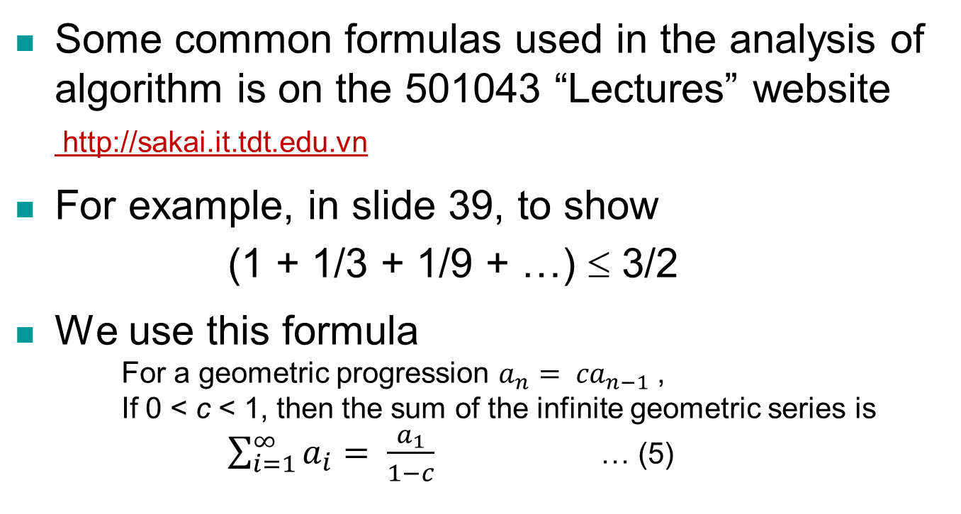
7.1 Formulas
a_{i} = 1; c = 1/3
Hence sum = 1/(1 – 1/3) = 3/2
[501043 Lecture 11: Analysis of Algorithms]

Slide 62
End of file

